Slide 1
Project Ultima
BY:
-Sangin Thapa Magar
-Ananda Aryal

Slide 2
User Modal
Can register with valid email.
User login
User Dashboard
Change Password
View order list
View purchase Product
Buy product (with login and without login)
Product buying status
View invoice in email and in website

Slide 3
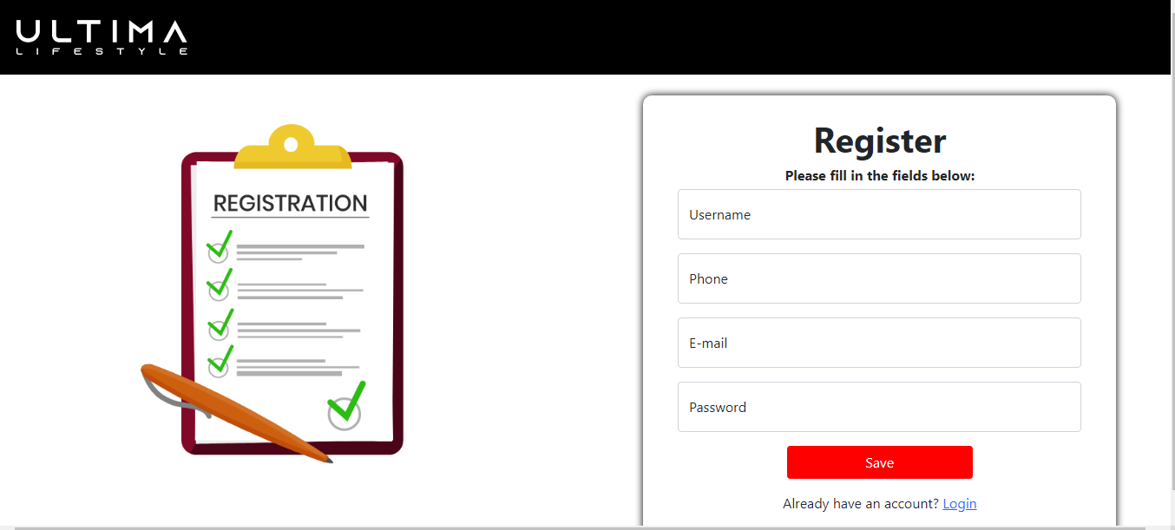
Can register with valid email.

Slide 4
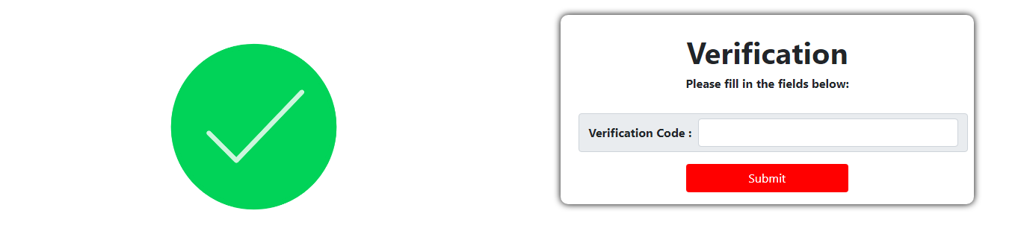
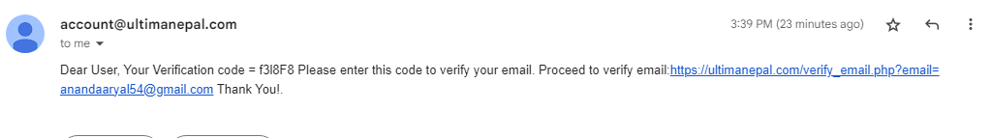
Verification(email)

Slide 5
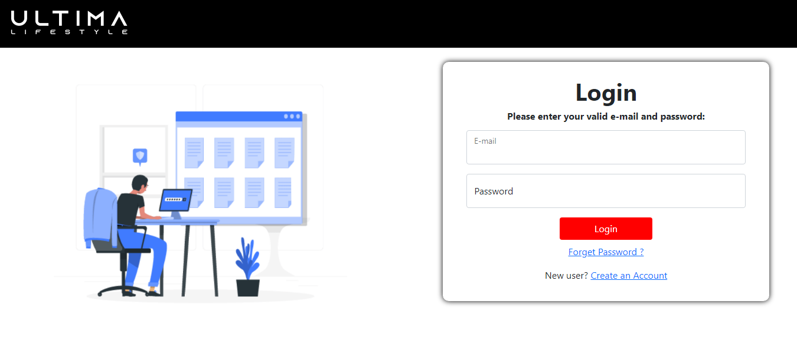
User login

Slide 6
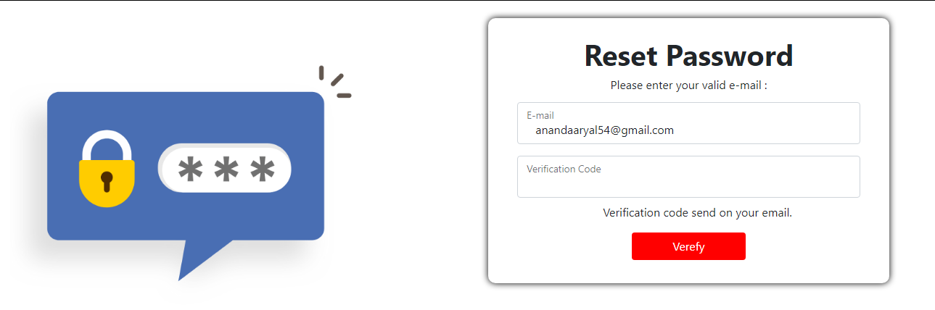
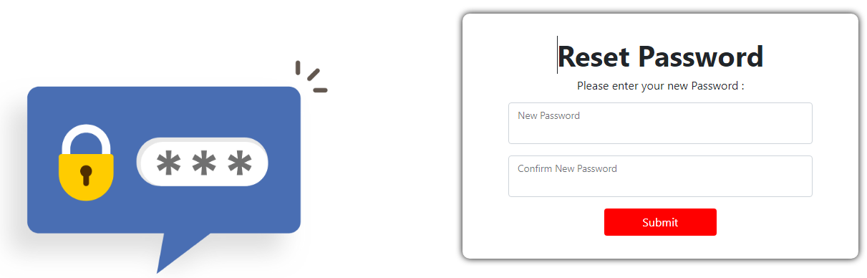
Change Password(code in email)

Slide 7
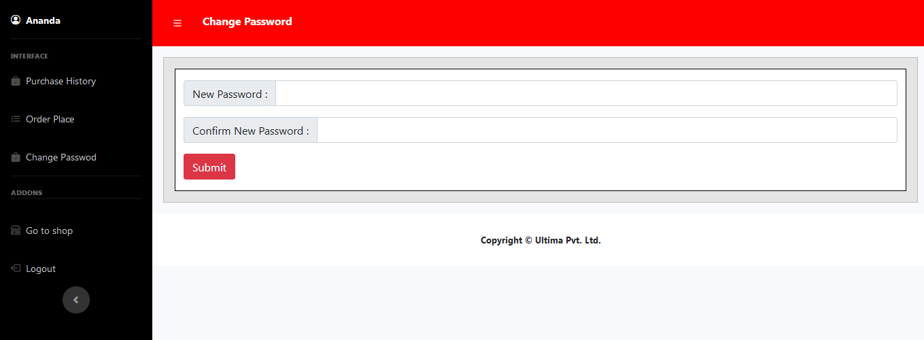
User Dashboard
Change Password

Slide 8
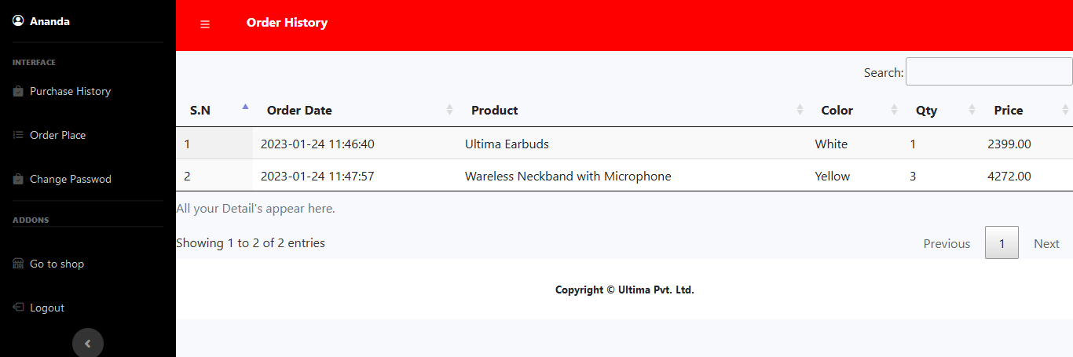
Order History

Slide 9
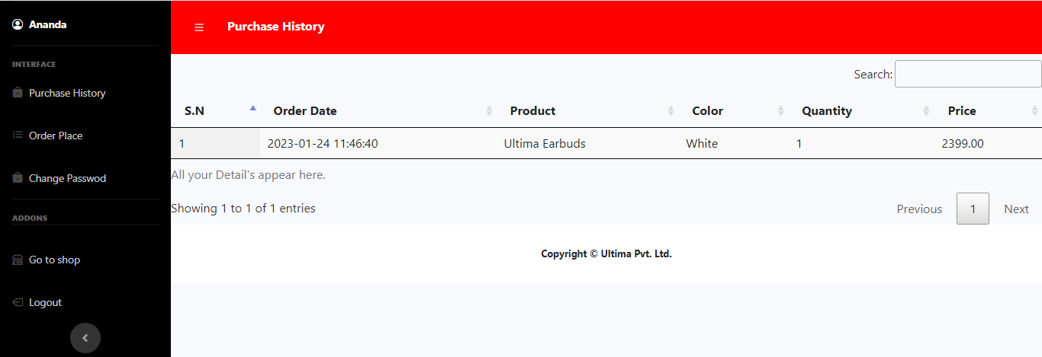
View purchase Product

Slide 10
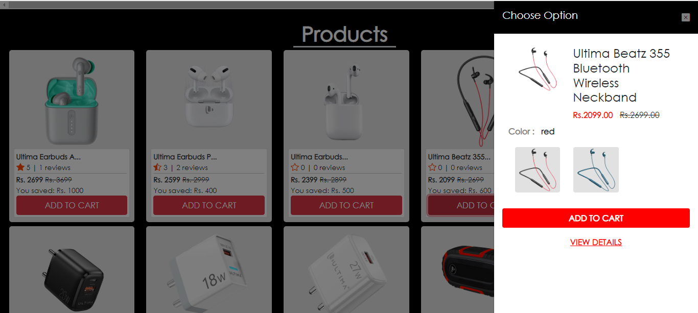
Buy product (with login and without login)

Slide 11
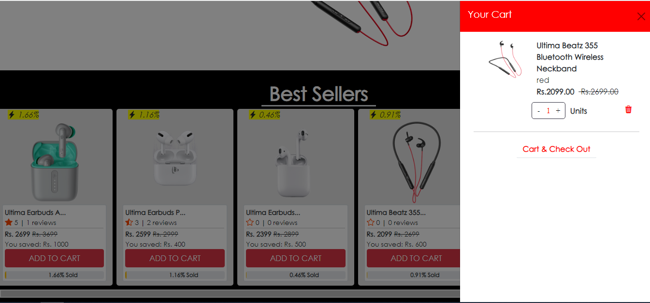

Slide 12
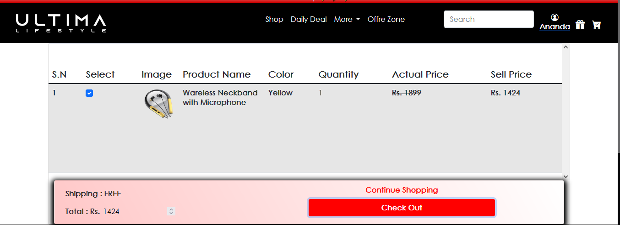

Slide 13
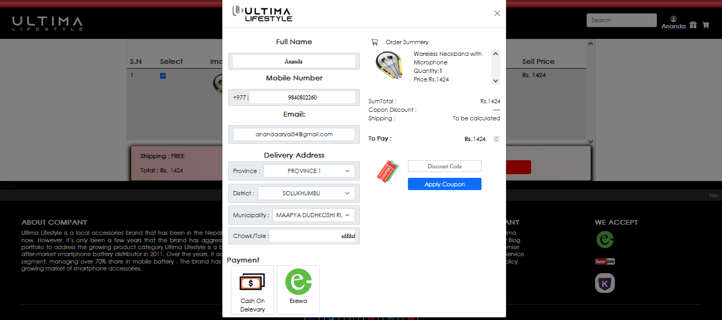

Slide 14
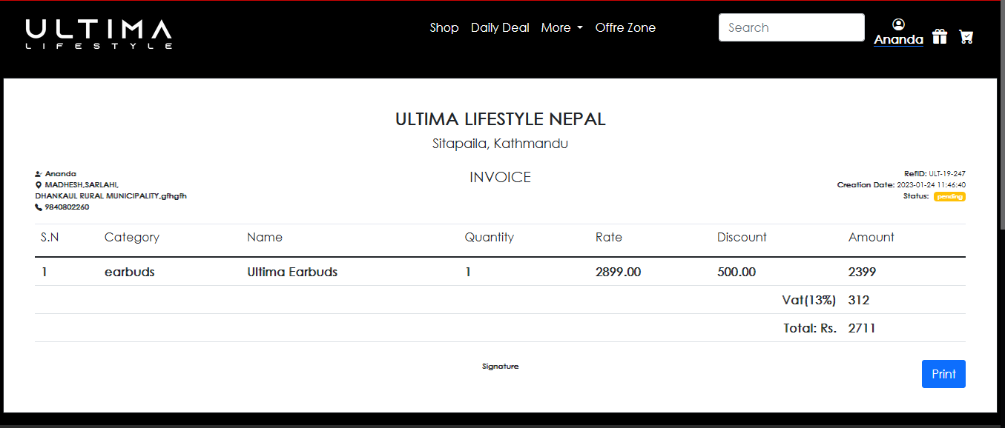
View invoice in email and in website

Slide 15
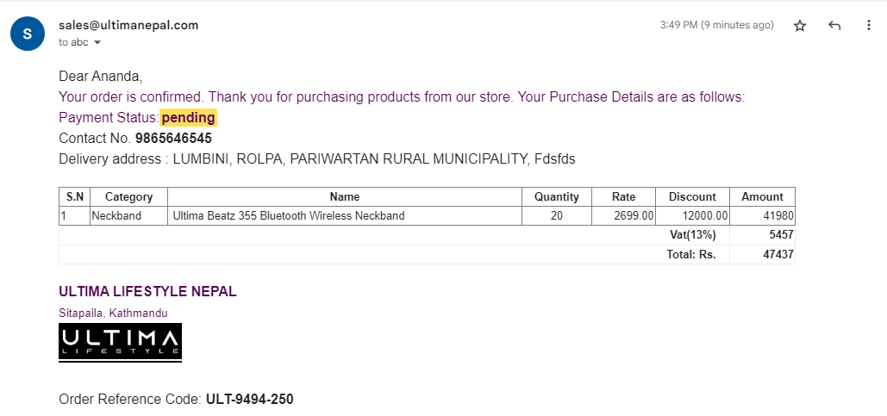

Slide 16
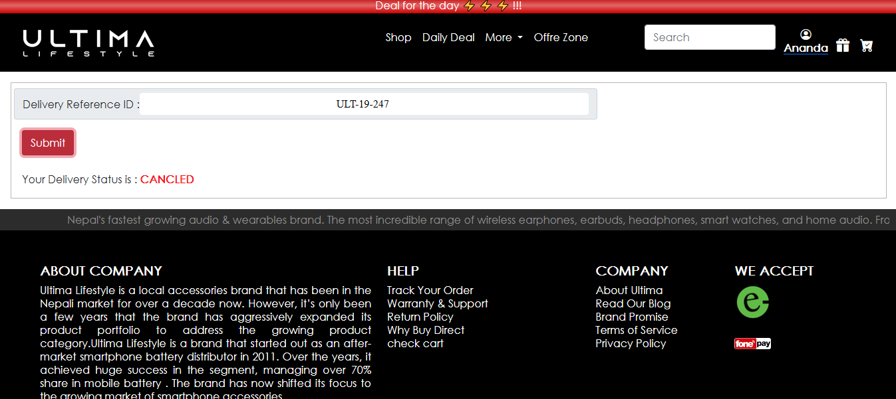
Product buying status

Slide 17
Admin Model
Dashboard View report( pi-chart, bar-graph)
Add update and delete product( category, product and variant).
New launch product
Add color
View add to cart
View checkout(payment status, delivery status, close delivered product, print invoice).
View delivered product status(who, whom, when product deliver and who close the product).
View review
FAQ’s(add, update, delete)
Add and delete carousel
View user
All products
New admin

Slide 18
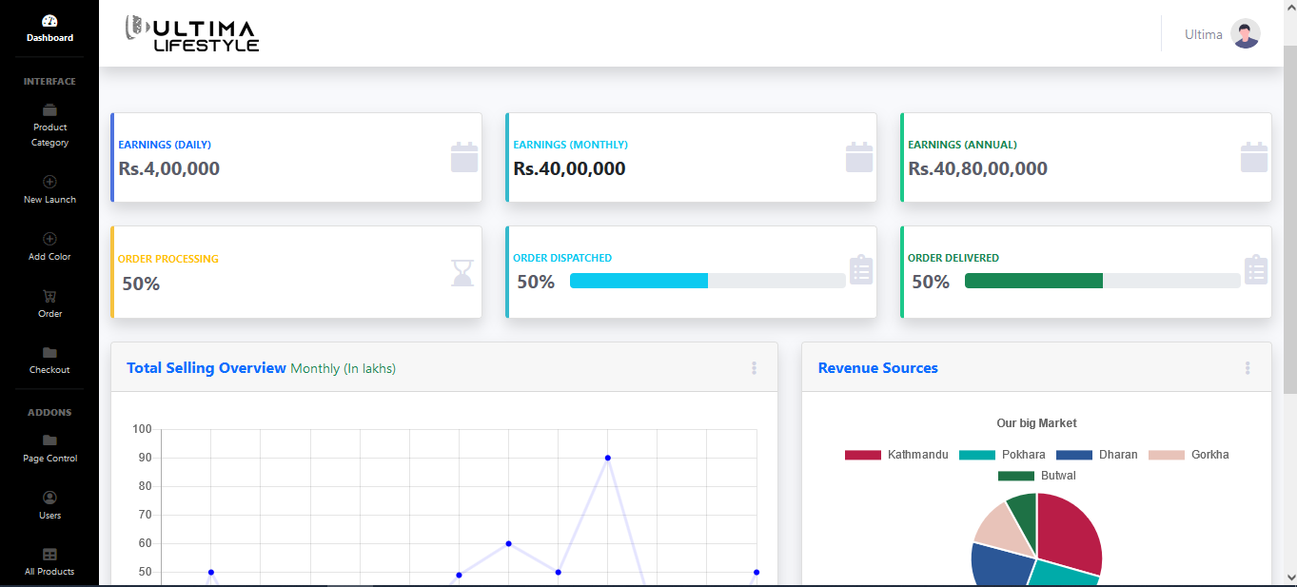
Dashboard View report( pi-chart, bar-graph)

Slide 19
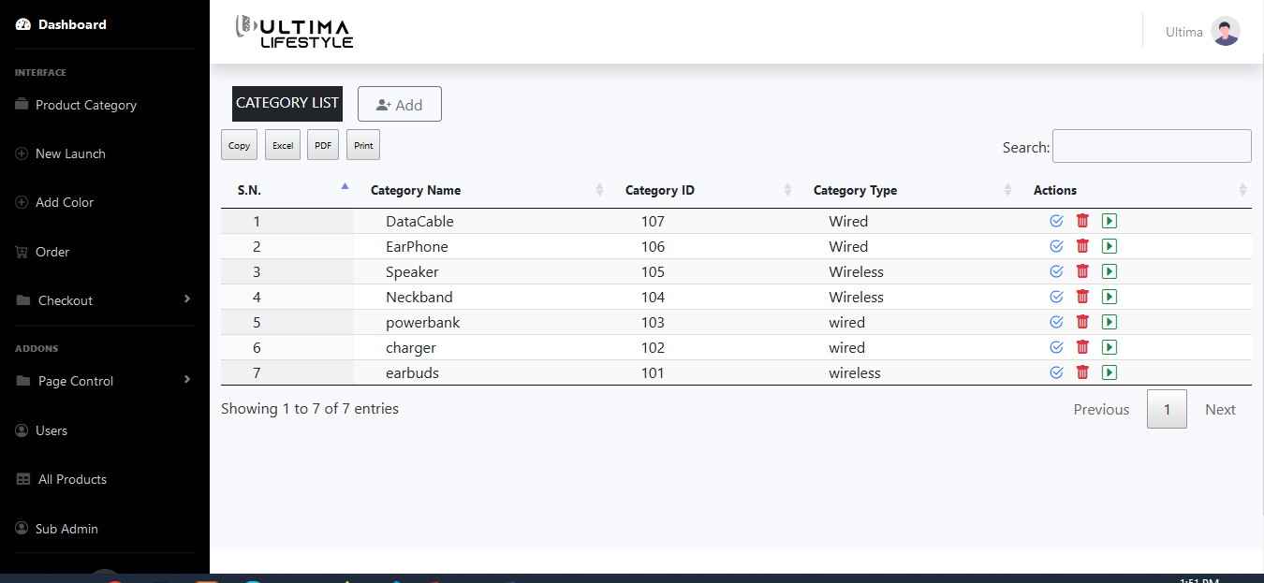
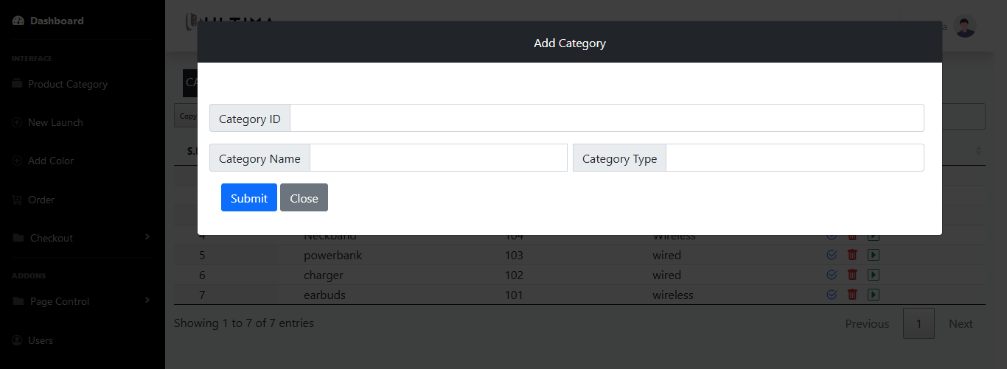
Add update and delete product( category, product and variant).
Category( Add, Update and Delete)

Slide 20
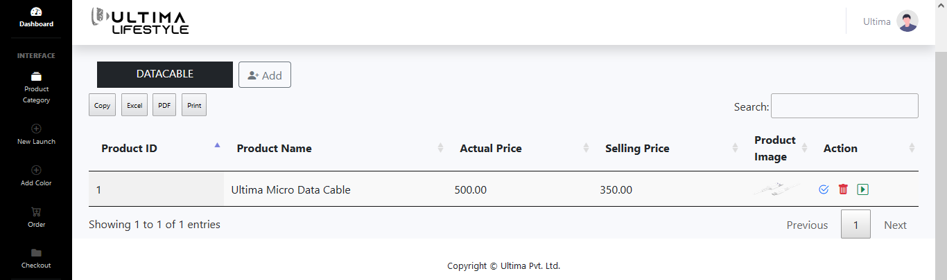
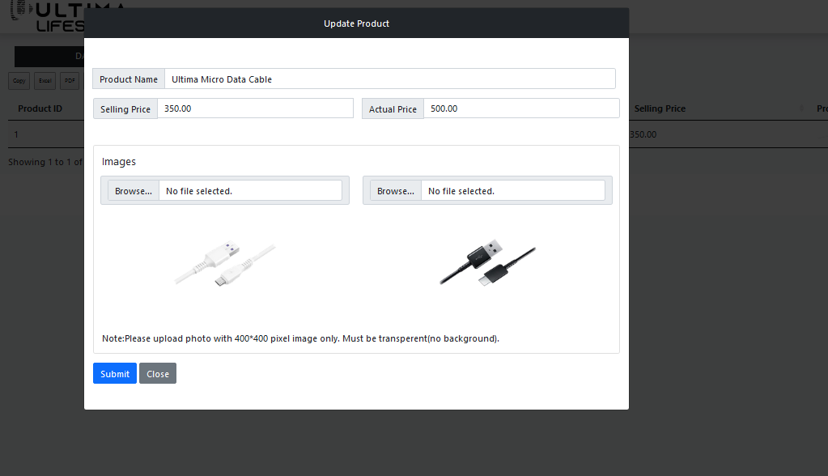
Product( Add, Update, Delete)

Slide 21
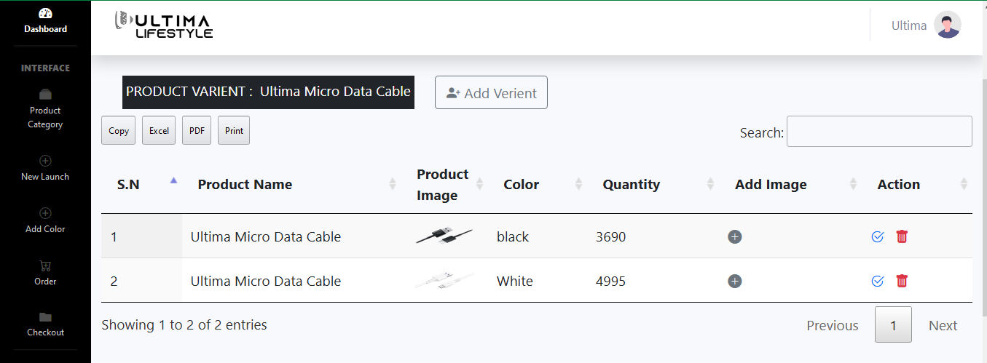
Product Variant

Slide 22
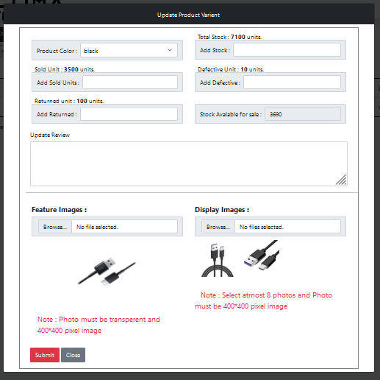

Slide 23
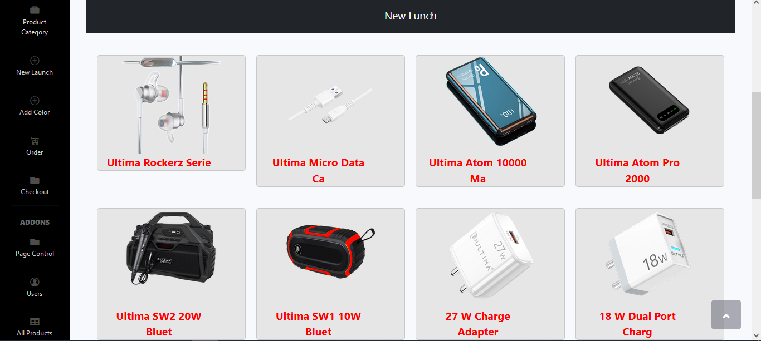
New launch product

Slide 24
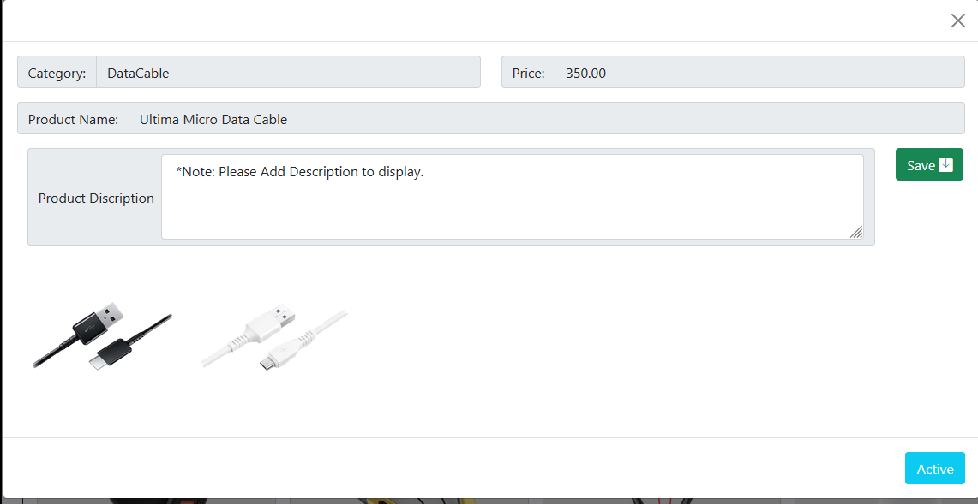

Slide 25
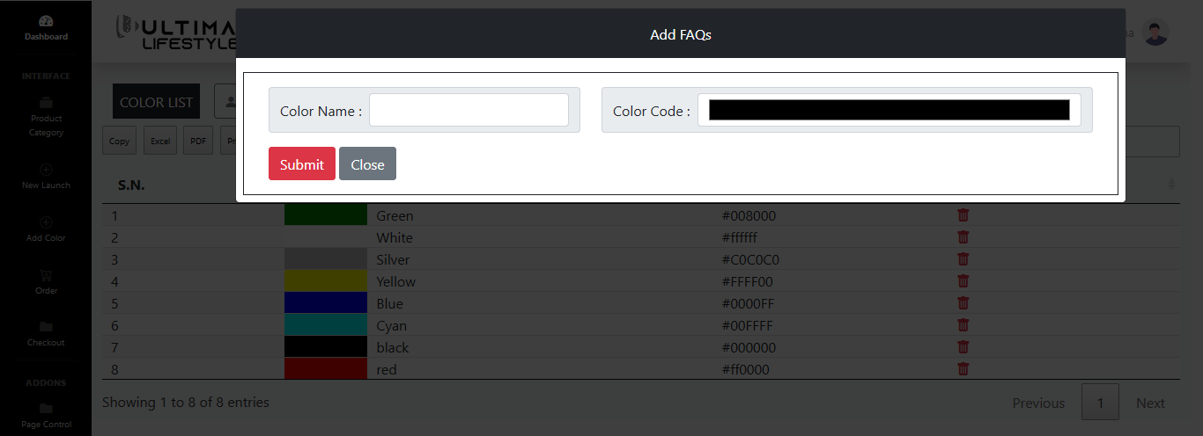
Add color

Slide 26
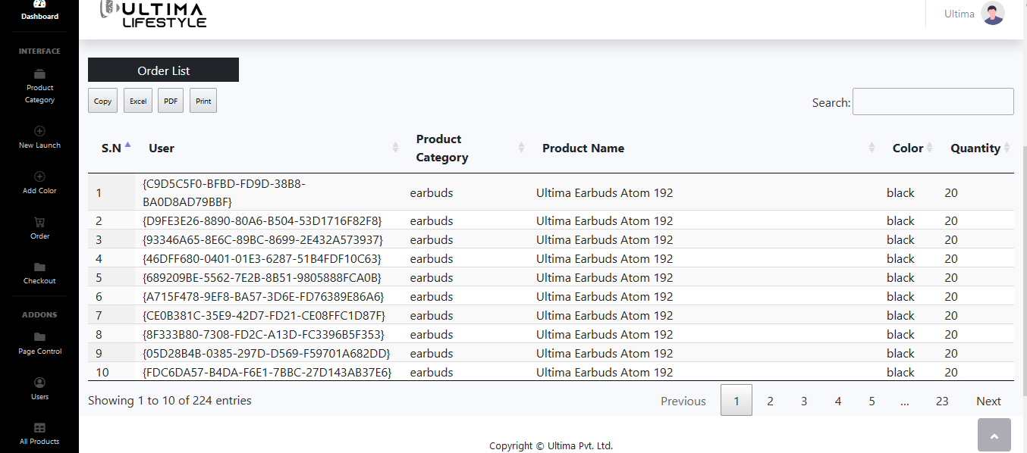
View add to cart

Slide 27
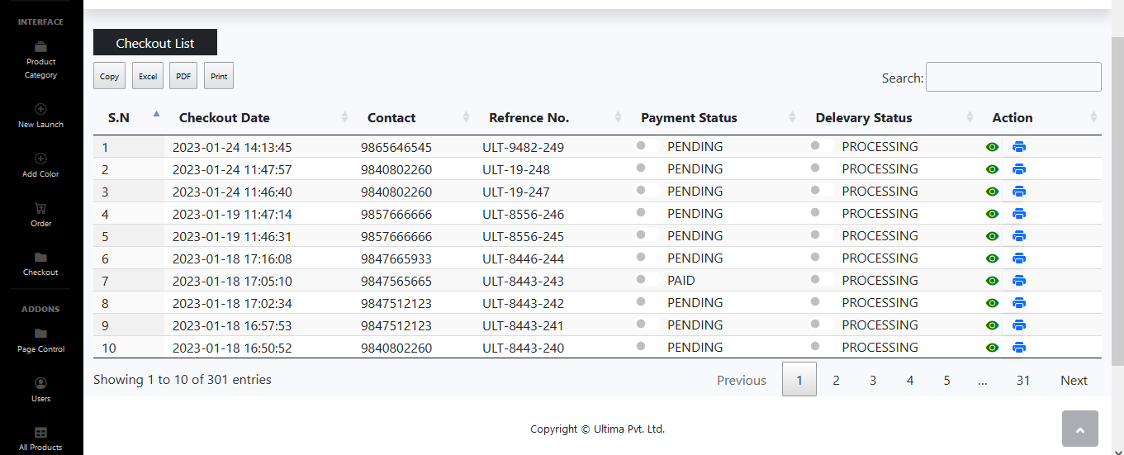
View checkout(payment status, delivery status, close delivered product, print invoice).
Checkout list

Slide 28
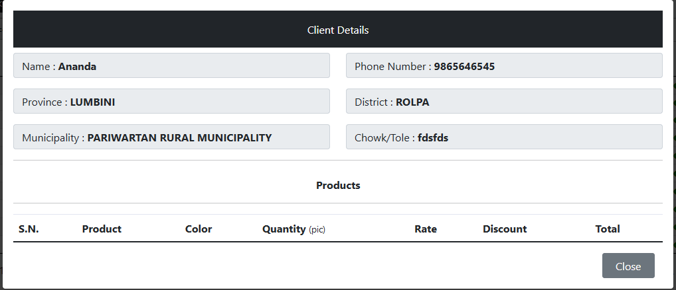

Slide 29
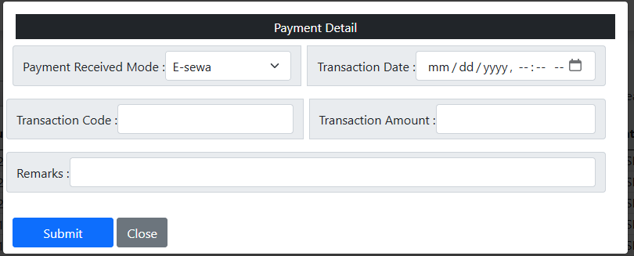
Payment status

Slide 30
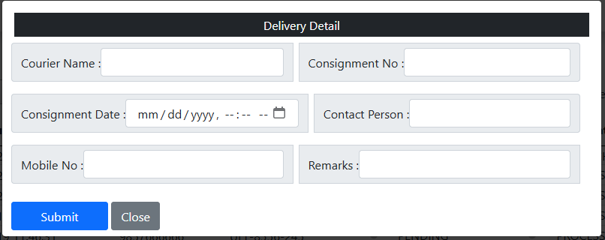
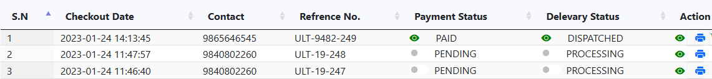
Delivery status

Slide 31
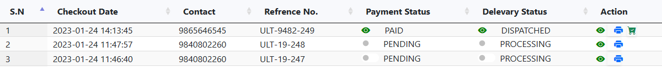
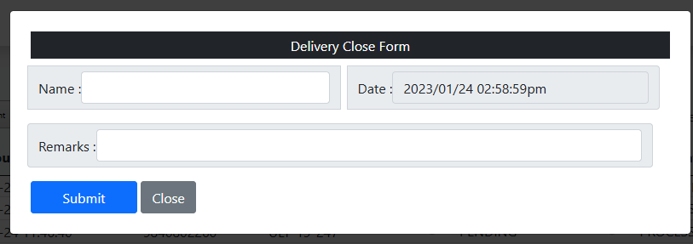
Close Delivery Product

Slide 32
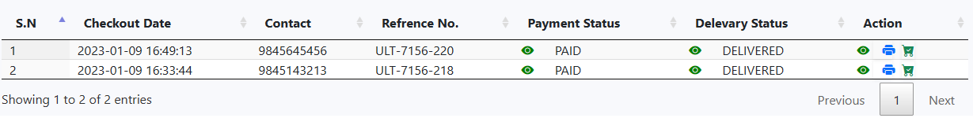
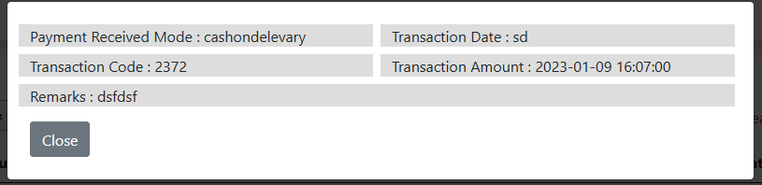
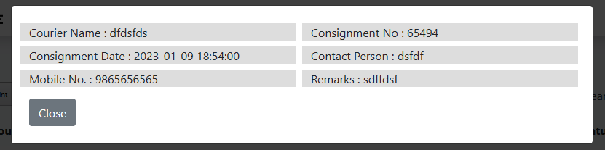
Delivered Product(View list, payment method,delivery detail,close product)

Slide 33
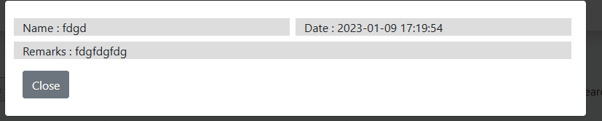
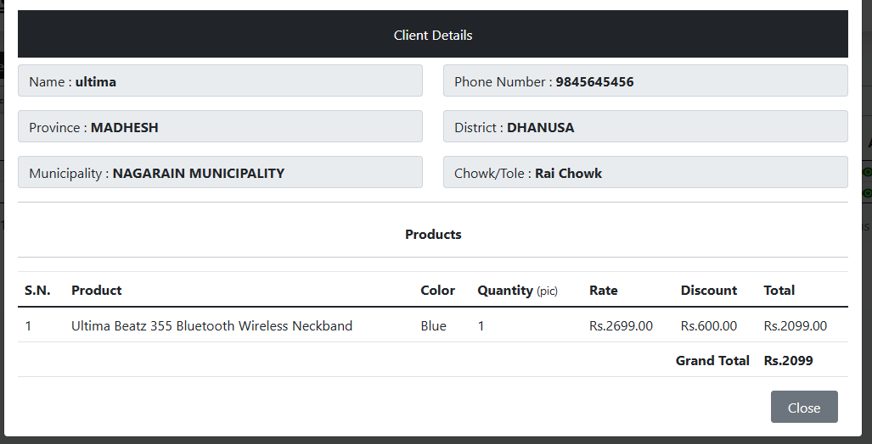

Slide 34
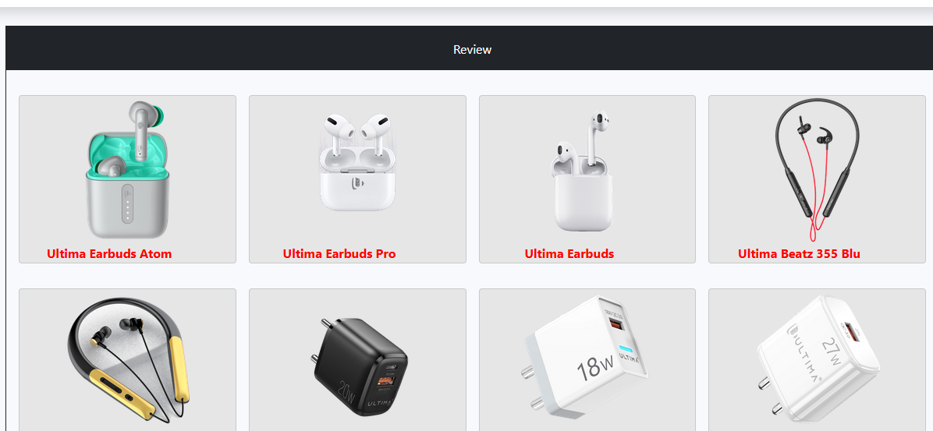
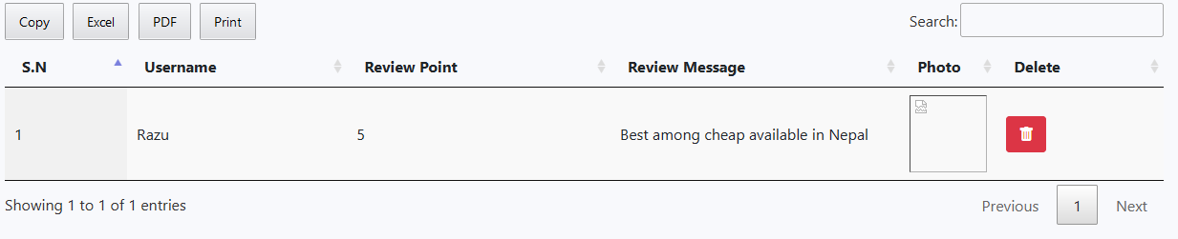
View review

Slide 35
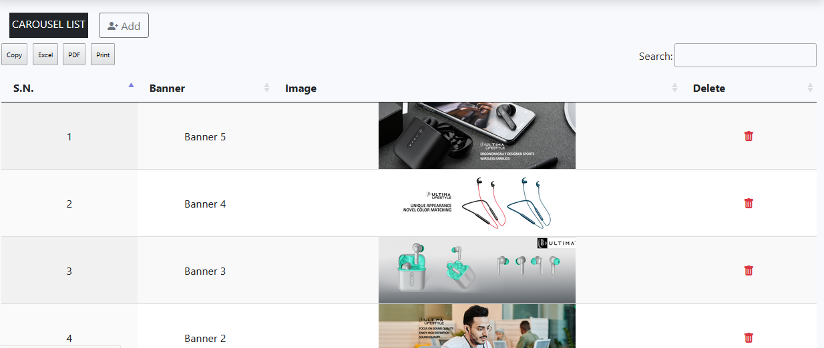
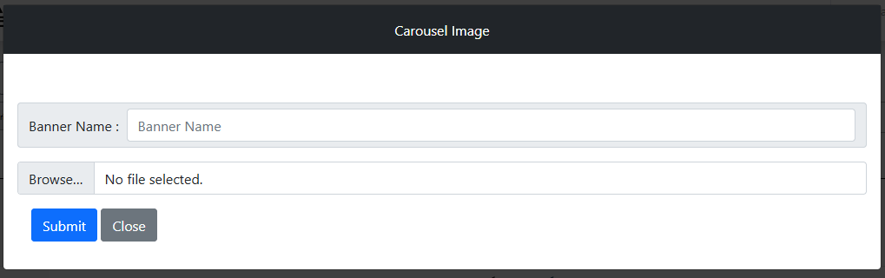
Carousel

Slide 36
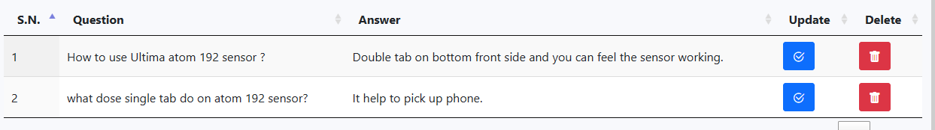
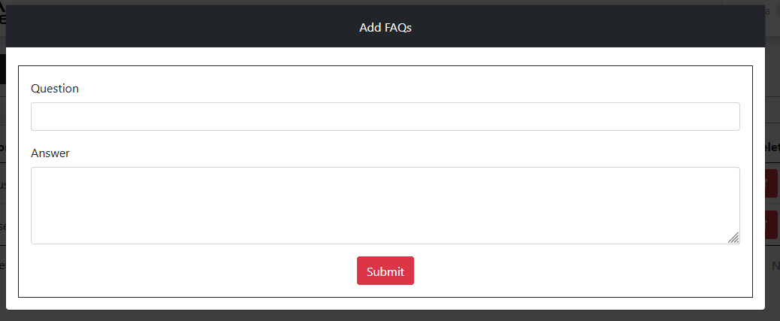
FAQ’s

Slide 37
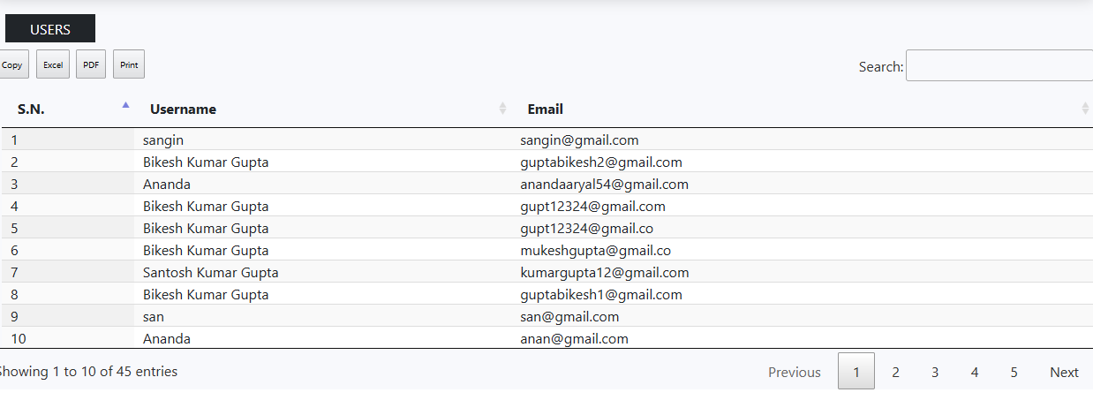
Users

Slide 38
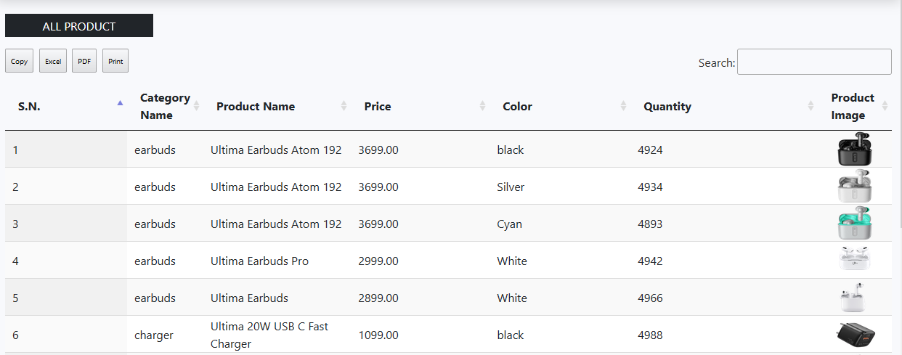
All product

